Slide 1
Sentence Adverbs and Emphasizing Particles
Prof. Vanessa Gorman
University of Nebraska-Lincoln
vgorman1@unl.edu

Slide 2
Sentence Adverbs
Short particles that add nuance to the sentence.
Short, indeclinable words with “functional meanings”
Overlap the categories of adverb and conjunction.
POS = adverb
Relation = AuxY
They are often the equivalent of starting an English sentence with “however,” “for,” “yet,” etc.
Smyth 2771: They “often resist translation by separate words, which in English are frequently overemphatic and cumbersome in comparison … The force of such words is frequently best rendered by pause, stress, or alternations of pitch.”

Slide 3
Sentence Adverbs [AuxY] Usually hung on verbs or coordinators
First in the sentence
καὶ ὁ Θράσυλλος ἔπλευσε.
Postpositive
ὁ δὲ Θηραμένης ἔλεγεν.
Earlier conjunctions in a series
Φαρνάβαζος δὲ ἐβοήθει στρατιᾷ τε καὶ ἵπποις.
οἱ μὲν ἐμάχοντο, οἱ δʼ ἔφευγον.
Piled up
καὶ γὰρ οἱ Ἕλληνες ἔλεγον.

Slide 4
Most common sentence adverbs
Lemma | translate | usual label | count | PP?
ἀλλά | but, and | COORD/AuxY | 229 | no
γάρ | for | AuxY | 326 | yes
δέ | but, and | AuxY/COORD | 2996 | yes
καί | even, and | AuxY or Z or COORD | 3682 | no
μέν | Truly, [contrast] | AuxY | 1210 | yes
μέντοι | however | AuxY | 195 | yes
ὅμως | nevertheless | AuxY | 30 | no
οὖν | therefore | AuxY | 171 | yes
τε | and | AuxY/COORD | 654 | yes

Slide 5
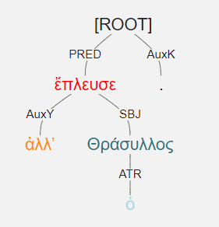
ἀλλʼ ὁ Θράσυλλος ἔπλευσε.

Slide 6
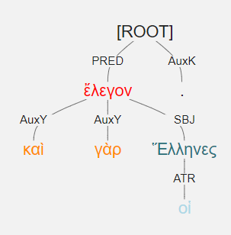
καὶ γὰρ οἱ Ἕλληνες ἔλεγον.

Slide 7
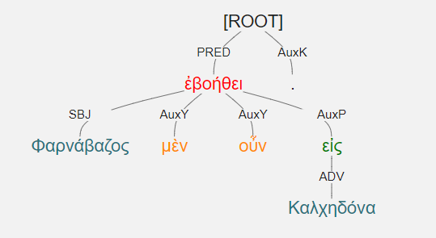
Φαρνάβαζος μὲν οὖν εἰς Καλχηδόνα ἐβοήθει.

Slide 8
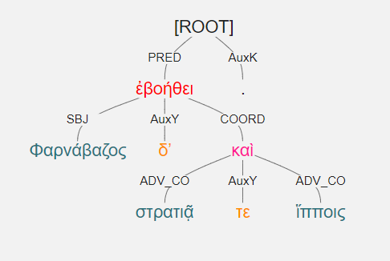
Φαρνάβαζος δʼ ἐβοήθει στρατιᾷ τε καὶ ἵπποις.

Slide 9
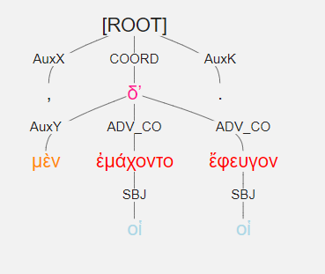
οἱ μὲν ἐμάχοντο, οἱ δʼ ἔφευγον.

Slide 10
“Emphasizing Particles”
These are words like “even,” “also,” “sort of,” “especially,” “I guess,” and also the negation (all forms of “not”).
Affect a word rather than the whole sentence/clause
POS = indeclinable adverb
Relationship label is AuxZ
Hangs on the word it affects
Often positioned right before or after it]

Slide 11
AuxZ
lemma | translate | usual label | count
γε | at least | AuxZ | 131
δή | truly | AuxY or Z | 226
καί | even, and | AuxY or Z or COORD | 3682
μήν | truly | AuxZ or Y | 75
οὐκ/οὐ | not | AuxZ | 511
οὐδέ | and not; neither..nor | AuxZ/COORD | 76
οὐκέτι | not yet | AuxZ | 29
οὔτε | and not; neither..nor | AuxZ/COORD | 63
ὡς | [context] | AuxZ | 548

Slide 12
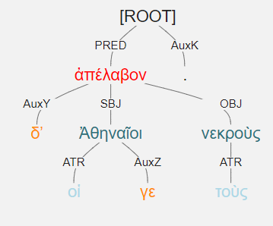
οἱ δʼ Ἀθηναῖοι γε τοὺς νεκροὺς ἀπέλαβον.

Slide 13
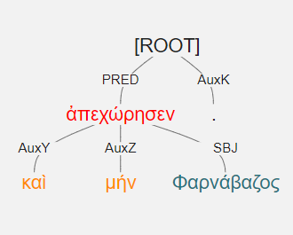
καὶ μήν Φαρνάβαζος ἀπεχώρησεν.

Slide 14
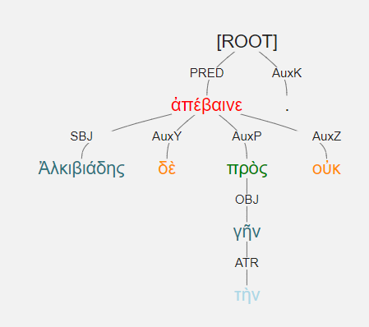
Ἀλκιβιάδης δὲ πρὸς τὴν γῆν οὐκ ἀπέβαινε.

Slide 15
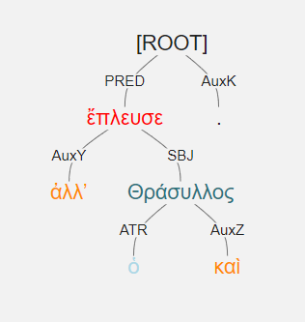
ἀλλʼ ὁ Θράσυλλος καὶ ἔπλευσε.

Slide 16
Handout
 | lemma | translate | usual label | count
1 | ἀλλά | but, and | AuxY/COORD | 229
2 | γάρ | for | AuxY | 326
3 | γε | at least | AuxZ | 131
4 | δέ | but, and | AuxY/COORD | 2996
5 | δή | truly | AuxY or Z | 226
6 | καί | even, and | AuxY or Z or COORD | 3682
7 | μέν | truly | AuxY | 1210
8 | μέντοι | however | AuxY | 195
9 | μήν | truly | AuxZ or Y | 75
10 | ὅμως | nevertheless | AuxY | 30
11 | οὐκ/οὐ | not | AuxZ | 511
12 | οὐδέ | and not; neither..nor | AuxZ/COORD | 76
13 | οὐκέτι | not yet | AuxZ | 29
14 | οὖν | therefore | AuxY | 171
15 | οὔτε | and not; neither...nor | AuxZ/COORD | 63
16 | τε | and | AuxY/COORD | 654
17 | ὡς | [context] | AuxZ | 548

